Slide 1
The Age of Absolutism

Slide 2
Focus Question
What events led to the rise of absolute monarchies?

Slide 3
Objective
Students will be able to identify and explain at least 2 reasons for the rise of Absolutism.

Slide 4
Absolute Rule
Absolute Monarchy- ruler with complete authority over the government and the lives of the people
Divine Right- Ruler’s authority to rule comes directly from God.

Slide 5
Absolutism Rises
Increased power of central government
-Stronger Armies
-Extended Borders
-Improved economies/commerce
-Compromises with Nobility/Aristocracy
Divine Right theory
Wars
Lawlessness resulting from wars (power vacuums)

Slide 6
Absolute Rule in Europe Spanish Power Grows
Phillip II ruled with absolute rule (42 year reign)
Expanded Spanish influence
Strengthened Catholic Church
Strong central government
Married 4 women, each from strong European countries
-Portugal, England, France, Austria
Formed alliances

Slide 7
Louis XIV Rises
Took throne at age 5
When of age, claimed he was the state and had absolute power (Divine Rule)
Focused on extended Royal Power
Built Versailles
Supported the Arts (Patron)
Extravagant Royal ceremonies

Slide 8
Decline of France
Louis XIV rules for 72 years
Poor decisions lead to decline
-Too many costly wars
-Too many enemies in Europe
-Persecuted Huguenots (revoked Edict of Nance)
100,000 Huguenots fled France
Devastating economic results

Slide 9
Absolute Rule in Russia
Peter the Great (Travels West/Learns from West)
-Modernized Russia (social & economic reforms)
-Westernization
- Strengthen Military
- Expand borders
-Centralize Royal Power
-St. Petersburg (Magnificent new capital)
-Warm water port on Baltic

Slide 10
Catherine the Great
German Princess at age 15 married Peter III
Peter III= Mentally unstable/murdered in 1762
Catherine the Great asserts absolute rule
Enlightened Ruler/Embraced Western ways
-reorganized govt - codifed laws -education
Gave more power to nobles = bad for peasants

Slide 11
English Absolutism
1485- 1603 Tudor monarchs believed in divine right rule but worked with parliament (valuable)
Century of revolution begins with bad rulers
Long Parliament from 1640 1653 takes control
Tries and executes rulers/officials

Slide 12
Absolute Rule in England
English Bill of Rights after years of revolution and civil war
Parliament has power over monarchy
England rid of absolute rule
Limited monarchy- constitution limits the monarch’s power
Constitutional gov- gov power is defined and limited by law

Slide 13
Exit Slip
Please write and explain on a sheet of paper at least 2 reasons for the rise of Absolutism.
Be specific and use evidence to support your answer!!!

Slide 14
The Age Of Enlightenment
NEW WAYS OF THINKING

Slide 15
Focus Question
How did Enlightenment thinkers inspire revolutionaries to push for radical changes in government and society?

Slide 16
OBJECTIVE
Students will be able to identify at least 3 results of Enlightenment thinkers and their influence.

Slide 17
Scientific Revolution Sparks Enlightenment
The Renaissance and the Reformation make way for the scientific revolution
-New way of thinking about the universe
-Mathematical laws govern nature
Success of the Scientific Revolution convinced Europeans of the power of human reason
Natural Law: rules discoverable by reason by reason that were applied to human behavior and society

Slide 18
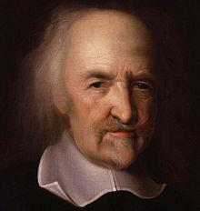
English Enlightenment Thinkers
Thomas Hobbes- Book= Leviathan
Argued people naturally greedy/cruel
Social Contract: give up freedom for organized society
Best form of government= absolute monarchy

Slide 19
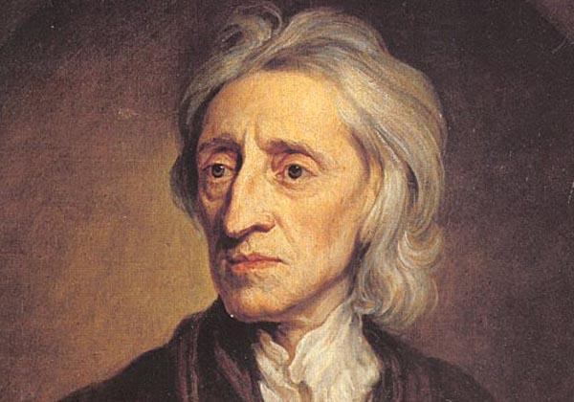
English Enlightenment Thinkers Cont
John Locke- Book= Two Treatises of Government
Argued government formed to protect natural rights of the people
Proposed that people should have the right to overthrow government
Best Gov had limited power and accepted by all citizens

Slide 20
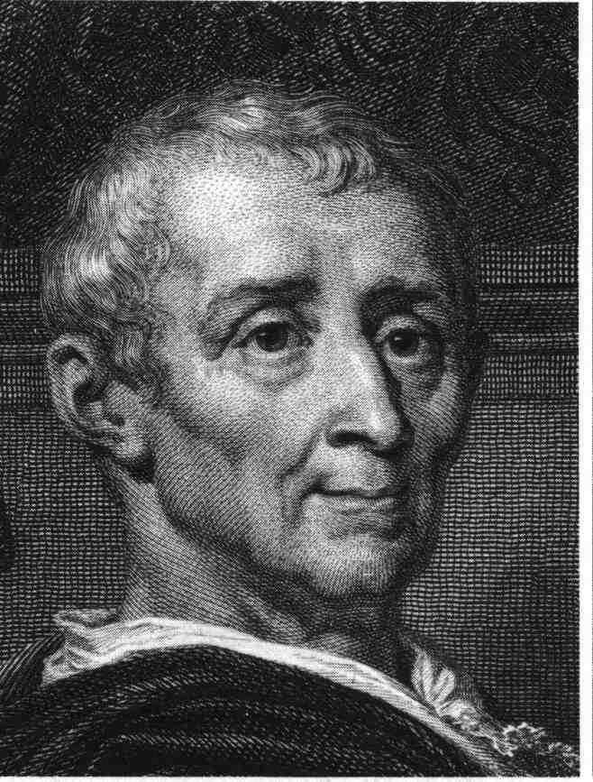
French Enlightenment Thinkers
Philosophes- French Philosophers
Salon- a gathering where people could exchange ideas
Montesquieu- Book: The Spirit of the Laws
3 Branches of Government
Checks and Balances

Slide 21
Voltaire
Used wit and sarcasm to attack enemies in writing
Wrote about inequality, injustice, superstition
Imprisoned and thrown into exile
Censorship-restricting access to ideas and information

Slide 22
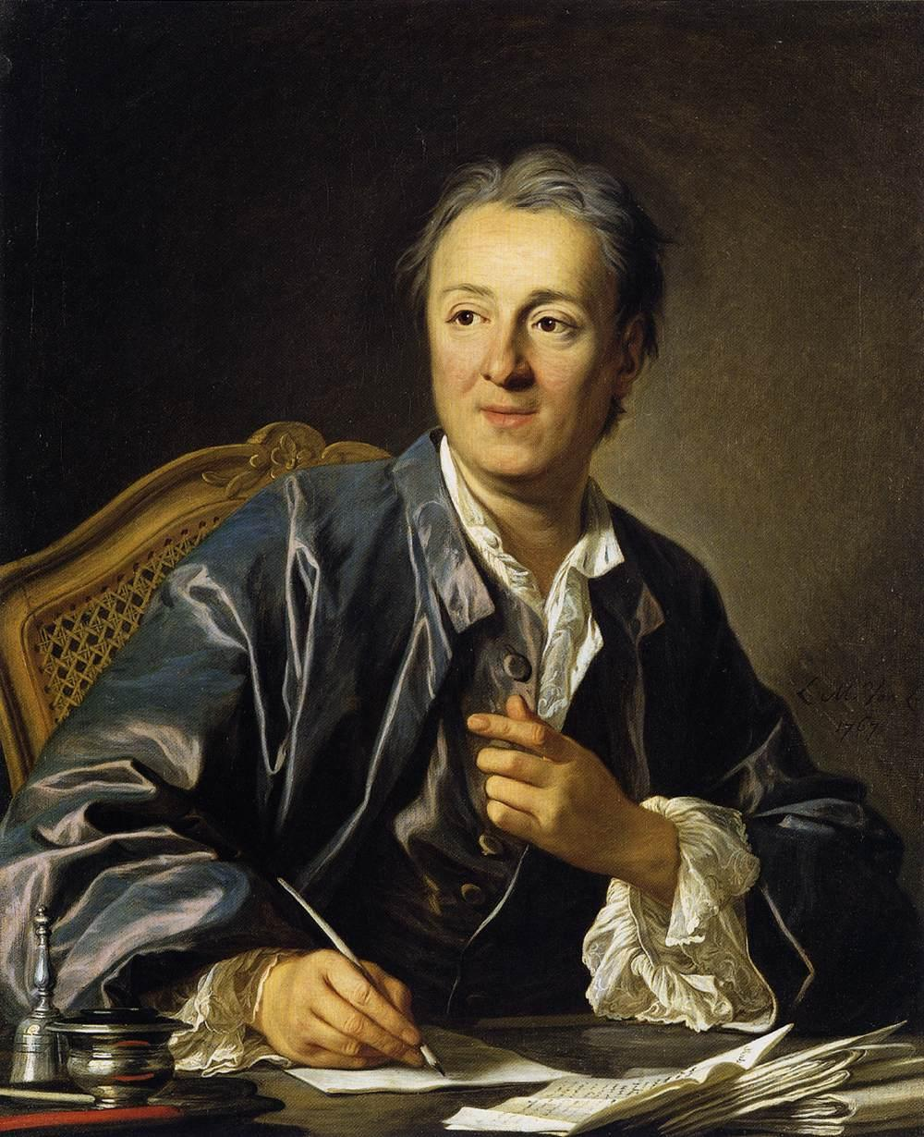
Diderot
Diderot- Book- 28 Volume Encyclopedia
Included articles from Montesquieu and Voltaire
Wrote about the horrors of slavery, freedom of expression, and education for all

Slide 23
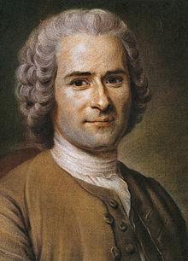
Rousseau
Rousseau- Book- The Social Contract
Argued that people in their natural state are “good” and society corrupts our innocence.
Society sets too many limitations on people's behaviors
Only Freely elected government should have control

Slide 24
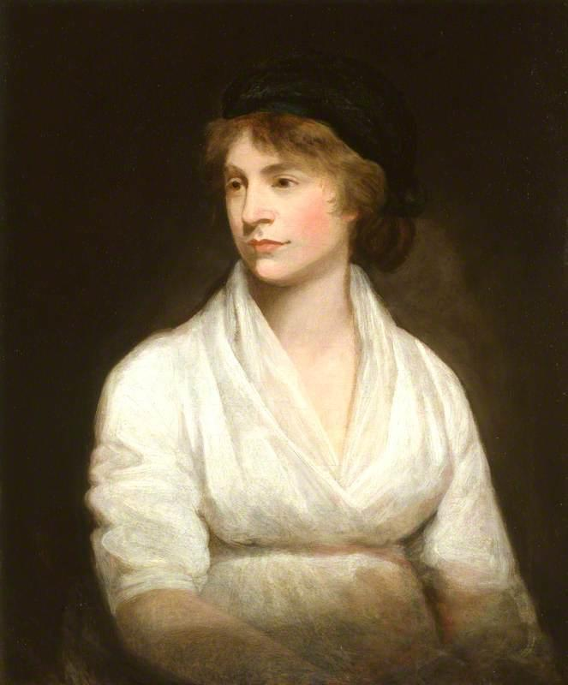
Women during the Enlightenment
Mary Wollstonecraft- Well known British social critic
1792 Publishes A Vindication of the Rights of a Woman
Argued that women should be able to decide without their husbands

Slide 25
Economic Changes
Mercantilism- economic system based on balance of trade
Laissez-Faire- Allowing business to operate with little to no government influence
Adam Smith- Free market, supply/demand

Slide 26
Enlightenment Ideas/Results
Governments power comes from the people
People have natural rights to life, liberty, and property
Separation of powers
Checks and balances
New ways of viewing justice
New ways of viewing equality

Slide 27
Exit Slip
On a separate sheet of paper please write down and explain at least 3 results of the Enlightenment Thinkers.
Be specific and use evidence to support your answer!!!

