Slide 1
The Cold War
US vs USSR

Slide 2
What is a Cold War?
A Cold War is a state of tension and hostility between nations without armed conflict.
Instead nations use propaganda, threats, and competition to “win” the war.

Slide 3
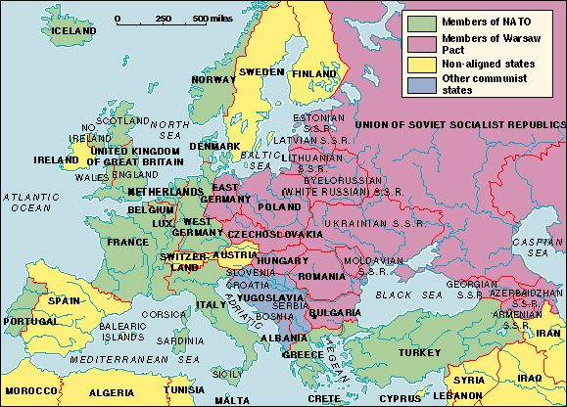

Slide 4
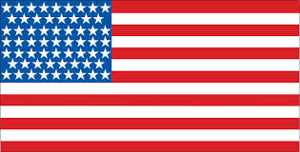
2 Super Powers Clash
US vs USSR
Emerged as superpowers after WWII
Superpower= an extremely powerful nation

Slide 5
Bipolar vs Multipolar
International relations based on “polarity” or the world, or how many countries hold influence in world politics
bipolar= 2 major world powers have a majority of power economically, militarily, politically,
Multipolar- several countries have power economically, militarily, and politically

Slide 6
Differing Ideologies
Communism vs Capitalism/Democracy
Communism- government and economy controlled by single ruler
Democracy- representative government
Capitalism- economy controlled by privately owned businesses, supply/demand

Slide 7
Ways they Competed
Influence on Berlin
Influence on 3rd World countries
Arms Race
Space Race
Technology
War overseas
Alliances

Slide 8
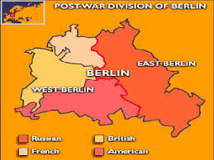
Influence in Berlin
Berlin is divided between the Allies after the war
USSR set up communist gov
Others democratic

Slide 9
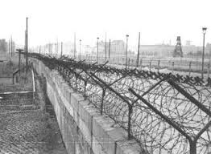
Influence in Berlin
Several East (commi) Berliners fleeing to West Berlin
Stalin puts up the Berlin Wall to keep citizens from fleeing to West (democratic) Berlin
East revolts against Stalin

Slide 10
Why are we fighting the USSR?
Containment- strategy to contain, or stop the spread of communism around the world
We would send military support to any nation facing a communist threat
Communist threat in China and Vietnam

