Slide 1
Causes/ Effects of the Economic Depression
1929-1939

Slide 2
What is an Economic Depression?
A long term downturn in economic activity

Slide 3
War Reparations
Treaty of Versailles makes Germany pay
Germany didn’t have enough money
Dawes Plan: US loans Germany money to pay off war debts; Allies use this money to pay US for war debts
Leaves all countries economically vulnerable

Slide 4
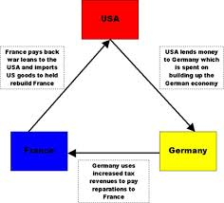

Slide 5
Overproduction of Agriculture
Exported crop values depreciated
Supply outweighed demand
Decrease in population, increase in farm machinery
High taxes on traded crops to protect local farmers

Slide 6
Stock Market Crash
Before the crash, stocks were booming
Several investing with borrowed money
Stocks fell, people who invested lots money
Banks tried to collect loans, some invested themselves using customers’ money and closed
US could not pay back loans to international countries

Slide 7
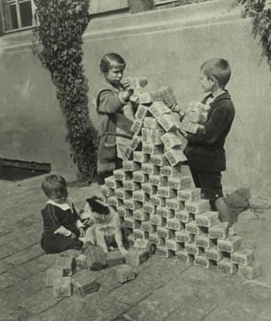
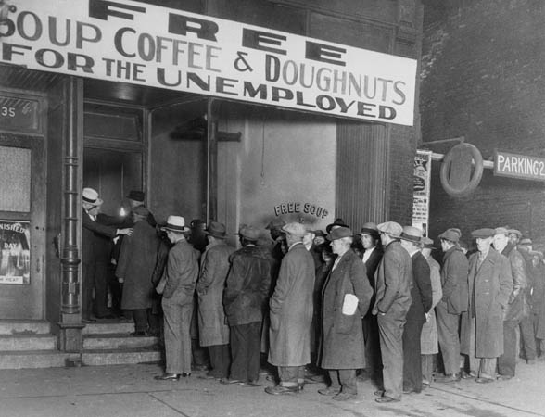

Slide 8
Uneven Wages
Large gap between rich and poor
Large production, but wages too small for everyday people to buy new products
Overproduction of goods, even rich could not buy much
Leads to layoffs, high taxes on imports, spread of global depression

Slide 9
Protectionism
Free Trade: international trade without tariffs (taxes) or restrictions
F.T. is the only way to have a strong global economy (fair competition)
Hawley-Smoot Tariff Act: High taxes on imports to US to protect US jobs/products from foreign competition
Countries filed protests or followed suit-halted trade, fed global depression
Hurt less developed countries that depended on imports

Slide 10
Effects
Hurt global trade
Less developed countries suffer more
High Unemployment
Extremist parties take power;dictatorship (Fascism, Communism, Totalitarianism)
New build up of military
Increase in labor unions

Slide 11
Effects Cont’d
New Deal: government created jobs, regulated banking, helped ease effects of depression
Banking Act: insurance on deposits
Social Security Act: pension when you retire

