Slide 1
The Renaissance
ch 13 section 1-2

Slide 2
Renaissance
Translates to “rebirth”
Time or art, philosophy, urban society
Emphasis on the individual/achievement
Time of Questioning
Most of Europe still deeply religious

Slide 3
Humanism
Studied classical cultures and tried to apply knowledge to present day
Believed education stimulated a person's creativity
humanities=grammar, rhetoric, poetry, history

Slide 4
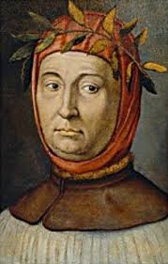
Francesco Petrarch
Poet/Scholar
assembled library of Greek and Roman manuscripts

Slide 5
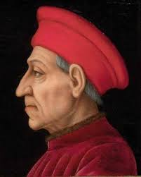
Government
Italy controlled by wealthy families
Families controlled city states
Medici Family- Florence

Slide 6
Art
Reflets ideas of humanism
Religious themes
Revived greek and roman technique
Perspective
Shading/oil paintings
Engraving-etching on metal plate

Slide 7
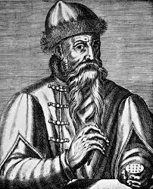
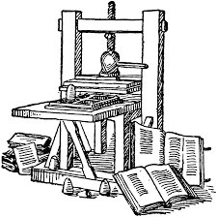
The Printing Press
Gutenberg
Moveable type- could print own bibles in vernacular

Slide 8
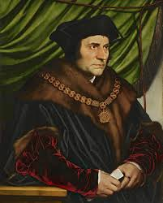
Sir Thomas More
Utopia- dream- perfect world
ideal society- education, justice to end crime

Slide 9
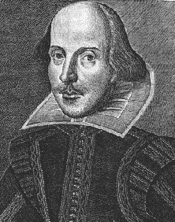
Shakespeare
Playwright
Universal Themes
Realistic Plots/Problems
Changed the English Language

