Slide 1
Cold War in the 3rd World
Guatemala, Congo, Indonesia, Nicaragua

Slide 2
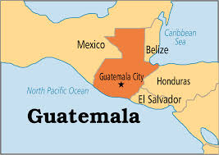
Guatemala

Slide 3
Guatemala
US gets involved in 1954 to overthrow the president, Jacobo Arbenz
Thought he did not have a strong enough distaste for communism
Some say US had economic interest to get rid of president

Slide 4
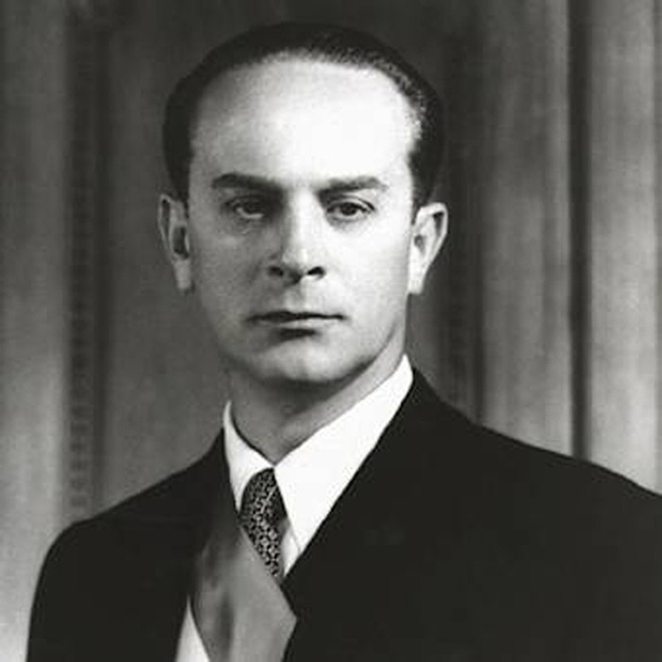
Jacobo Arbenz

Slide 5
Guatemala
Some say US got rid of Arbenz because he took over US land that was part of their banana trade
US wanted to get rid of him to claim back land and help themselves economically, not the Guatemalan people.

Slide 6
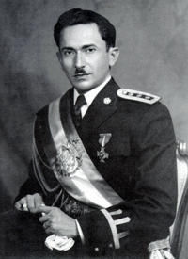
Guatemala
US trained troops from neighboring countries to overthrow Arbenz
Funded by CIA
Overthrow Arbenz and put Carlos Castillo Armas in power
48 US soldiers died in the coup

Slide 7
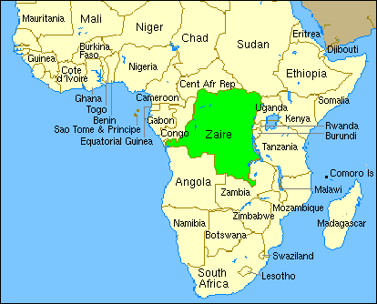
Congo

Slide 8
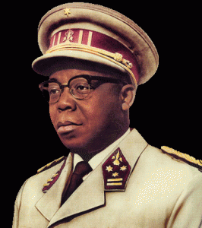
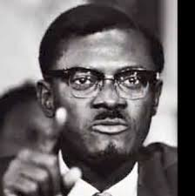
Congo
Congo trying to gain independence from Belgium
They elect Joseph Kasavubu as president and Patrice Lumumba as prime minister
Belgium wanted a gradual release to teach Congo how to rule

Slide 9
Congo
Civil unrest due to instability caused rich regions of Congo to separate and form their own countries
UN had to come help restore order
Lumumba wanted help and asked Soviets- US not happy

Slide 10
Congo
CIA convinced President Eisenhower that Lumumba was going to stage a communist revolution and needed to be taken out of power or assassinated
Colonel Joseph Mobutu- Army took over government- killed Lumumba-blamed him for Congo’s problems

Slide 11
Congo
Mobutu continued to rule and accept US aid if he let US have a say in who lead the country and had democratic ideals
Renamed Congo Zaire

Slide 12
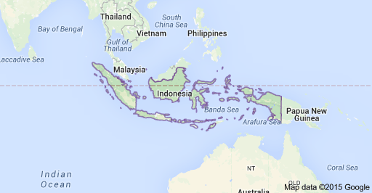
Indonesia

Slide 13
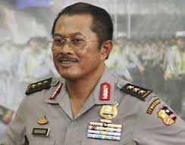
Indonesia
Sukarno Indonesian president after WWII. Had a blend of nationalism, religion, and communism
Communist group PKI were supporters of Sukarno

Slide 14
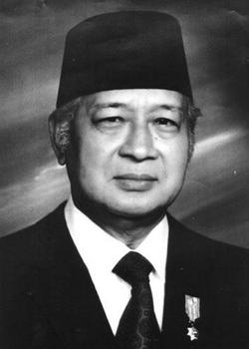
Indonesia
PKI tries to overthrow Sukarno and rule as full communist government
Failed
US supported candidate, Suharto, wins presidency
Starts communist purge that leaves 600,000 dead

Slide 15
Indonesia
Western democratic nations like the US did nothing about the violent massacre of communist and innocent civilians because it did not attack their democratic ideals

Slide 16
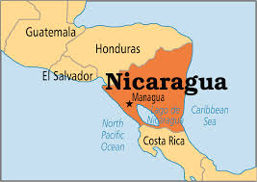
Nicaragua

Slide 17
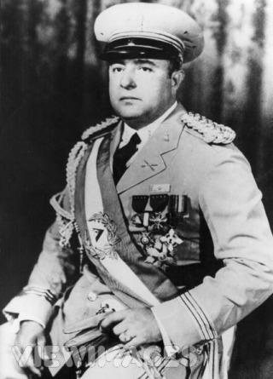
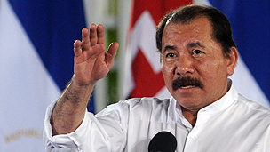
Nicaragua
§Important People:
§Somoza: U.S. supported Nicaraguan dictator
§Ortega: leader of communist Sandanistas in Nicaragua
§Events:
§Communists overthrow Somoza and are supported by the Soviets
§U.S. supports anti-communist rebels called the Contras
§Civil War in Nicaragua lasted until the 1990s

Slide 18
Nicaragua
Aftermath of Civil war:
Ortega “wins” civil war
60,000 dead
extremely weak economy
free elections- communist party voted out of power

