Slide 1
Consequences of WWI

Slide 2
War in Stalemate
Neither the Allies or Central powers are making major gains
Total War: war requiring all resources from a nation

Slide 3
Russian Revolution
Political instability in Russia forces it to withdrawal from WWI
Russia weak in the war effort due to lack of technology, resources
Monarchy overthrown in revolution

Slide 4
US joins the war
Lusitania-Germans sank British ship with Americans on board
Zimmermann Note- Germany promising Mexico Texas, New Mexico, and Arizona if Mexico supported Germany against US

Slide 5
WWI Ends
Germany Surrenders
Ottoman Empire collapses
Armistice November 11th, 1918, 11am

Slide 6
Paris Peace Conference
Leaders of “winning” side had conflicting ideas on peace
US wanted peace
British wanted Germany to pay millions to them
France wanted Germany crushed so it could never pose a threat again

Slide 7
Outcomes of the War
Treaty of Versailles
Peace treaty to end the war
Heavy reparations for the Germans
Demilitarize
Pay heavy fines
Give natural resources to allied powers
Causes economic depression

Slide 8
Outcomes of the War Cont’d
New Countries emerged from old empires
Mandates: territories controlled by Western powers
Britain and France got Germany’s colonies
Colonies hoped for independence after war, but did not receive it

Slide 9
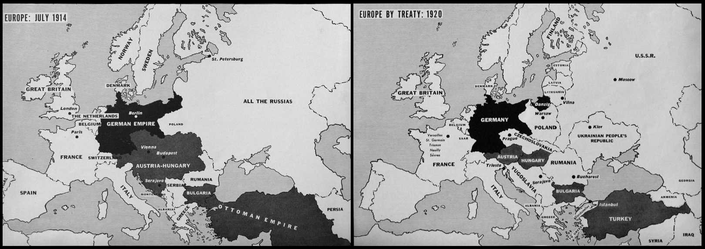

Slide 10
League of Nations
40 Nations joined
Meant to solve disputes through peace talks rather than war
US did not join

