Slide 1
The Protestant and Catholic Reformations
Ch 13 Sections 3&4

Slide 2
Abuses in the Catholic Church
Popes and Monarchs fighting
indulgences-forgiveness for sins by payment
“Tickets to Heaven”

Slide 3
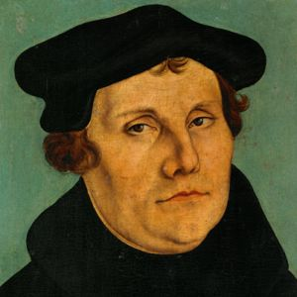
Martin Luther
Fed up with the Church
Nailed his 95 Theses to the church doors
Stated all arguments against indulgences
Pope has no authority over your admittance to heaven, can only be saved by faith

Slide 4
Martin Luther Cont’d
Luther called to apologize/give up his views
Luther refuses:excommunicated/heretic

Slide 5
Luther’s Teachings
Wanted ordinary people to read/interpret the Bible
Ban indulgences
Simplify mass/teachings

Slide 6
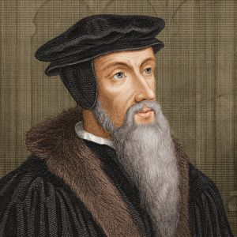
Calvinism
John Calvin
Predestination-God has predetermined fate
Set up theocracy, government run by church leaders, for himself and followers in Geneva
Hard work, honesty, morality

Slide 7
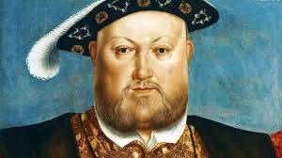
The Church of England
Henry VIII
Against the Protestant Reformation
Wanted a divorce;Pope refused to grant
Left the Catholic Church-created/lead the Church of England

Slide 8
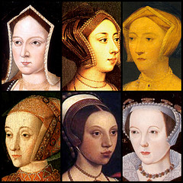
Henry VIII Cont’d
Married six times
“divorced, beheaded, died, divorced, beheaded, survived”
Only son, Edward VI took throne at age 9-died in his teens

Slide 9
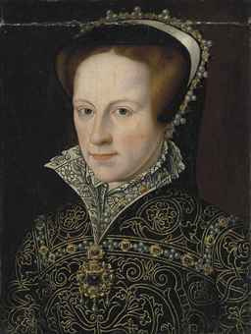
Mary Tudor
Devout Catholic
Killed protestants-nicknamed “Bloody Mary”
Not well liked, fell ill, replaced by her sister, Elizabeth

Slide 10
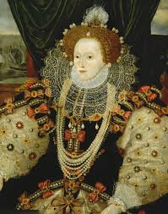
Queen Elizabeth I
Known for compromise during protestant reformation
Kept Church of England
Kept Catholic rituals
No more Latin services
Restored unity and peace

Slide 11
Catholic Reformation
Led by Pope Paul III
Wanted to fix problems/gain support for Catholic Church
Council of Trent- council created to meet/discuss/reform church
took steps to end abuses; still claimed salvation came from faith and good works;Bible is not only source for faith and guidance

Slide 12
Jesuits
New religious order
Founded by Ignatius of Loyola (spanish knight)
Catholic faith-rules to be member (practice)

Slide 13
Result of Catholic Reformation
Majority of Europe stayed Catholic, but Protestantism also popular
Witch Hunts
Restrictions on Jews

