Slide 1
The Russian Revolution

Slide 2
Russia Exits WWI
Political unrest caused Russia to withdrawal from WWI
Nicholas II steps down from throne in March
Placed under house arrest

Slide 3
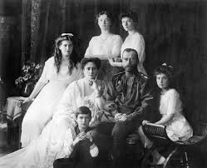
Romanov Family Executed
Bolsheviks take over the Russian Government
Romanov family killed by firing squad
Rumored children survived; proved false

Slide 4
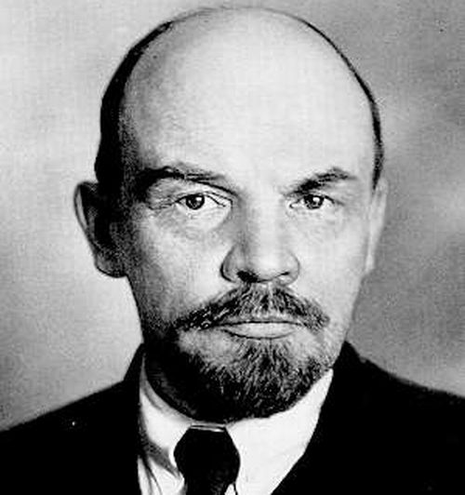
Bolshevik Revolution
Government shared between Duma and Soviets
Vladimir Lenin leads next revolution and overthrows the provisional government
1917 Lenin sets up a Marxist government (communism) Rules as a dictator

Slide 5
Soviet Union is born
Lenin faces opposition but wins in the end turning Russia into the Union of Soviet Socialist Republic
Makes peace with Germany
Starts Industrializing
Constitution, Supreme Soviet, Voting Rights
Mix of communism and capitalism

Slide 6
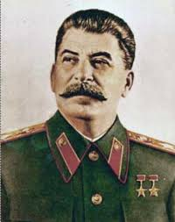
Stalin Takes Over
Lenin dies: Power struggle between Stalin and Leon Trotsky
Had differing views on politics
Stalin has Trotsky killed and takes over as next leader of USSR

