Slide 1
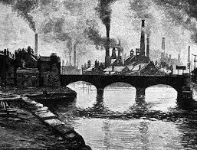
The Industrial Revolution

Slide 2
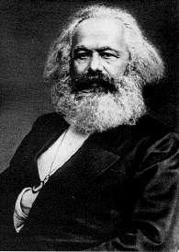
Communism
Government led by small elite group. Control every aspect of economic and political life
Karl Marx- “Communist Manifesto”
Classless society
Means of productions owned by community

Slide 3
Communism Cont’d
Proletariat= working class
Rise against the capitalists
Capitalism can never work because it brings prosperity to only a few people and not the community as a whole

Slide 4
Socialism
Social ownership of means of production
People as a whole would own farms, factories, railways, instead of individual people

Slide 5
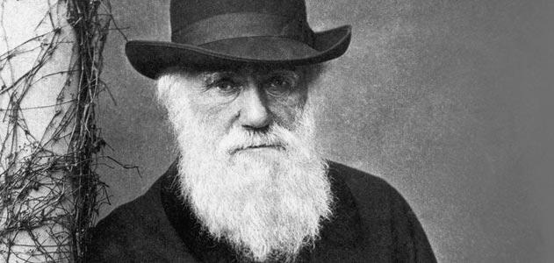
Charles Darwin
Proposed theory that species evolve in a slow process called evolution
Natural Selection- evolution +survival of the fittest
Social Darwinism- one racial group is superior to others
Applied to business and society

Slide 6
Agricultural Revolution
Dutch=
Combined Farmland
Manure for Fertilizer
British=
New Soils
Crop Rotation
Seed Drills

Slide 7
Agricultural Revolution Results
Population Increase
Surplus of Food
People eating well
Less death
Better sanitation

Slide 8
Britain Leads the Way
Why?
Lots of natural resources
Rivers
Canals
Accessibility to Ocean

Slide 9
Transportation
New forms of transportation becoming more popular
Railroads
Steam powered ships
Automobiles and Planes Popular in 1900

Slide 10
Important Inventions
Stepping away from Artisan Work
Spinning Jenny- James Hargreaves
Eli Whitney- Cotton Gin
Railroads
First rail-line from Liverpool to Machester in 1830

Slide 11
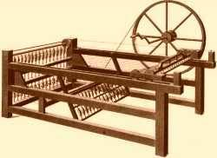
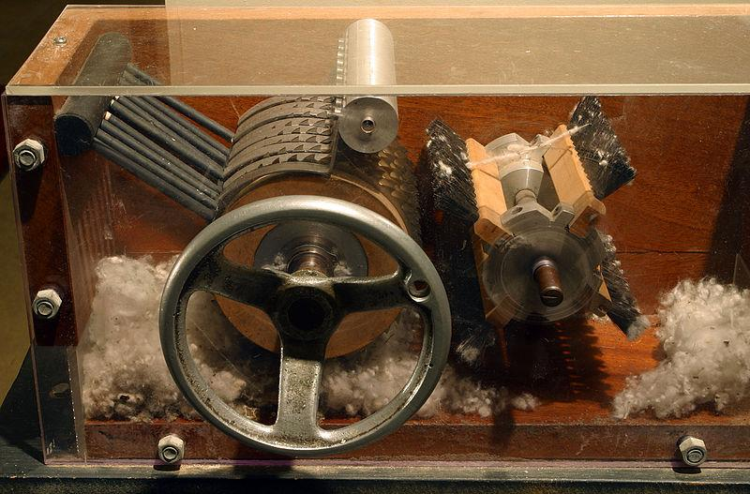

Slide 12
New Ways of Working
Interchangeable Parts- Identical parts that can be used other places
Assembly Lines-production method where workers repeatedly perform one task in the manufacturing process

Slide 13
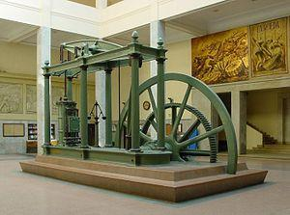
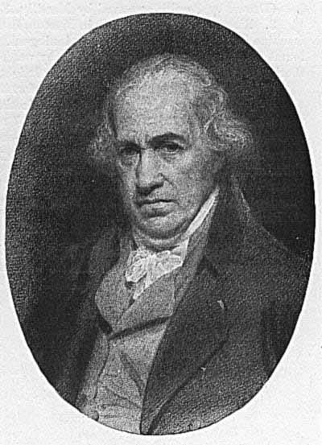
New Sources of Energy
Steam Engine
Invented by James Watt
Powered by coal
Could operate machinery

Slide 14
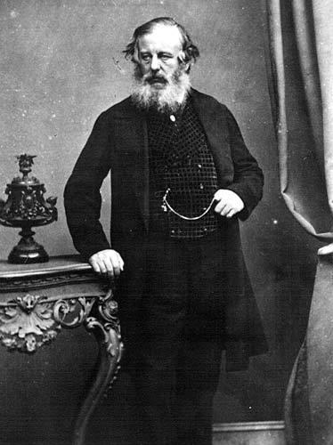
Abraham Darby
Used coal to smelt
Separated iron from iron ore
Grandson built the first iron bridge

Slide 15
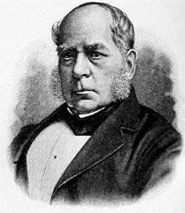
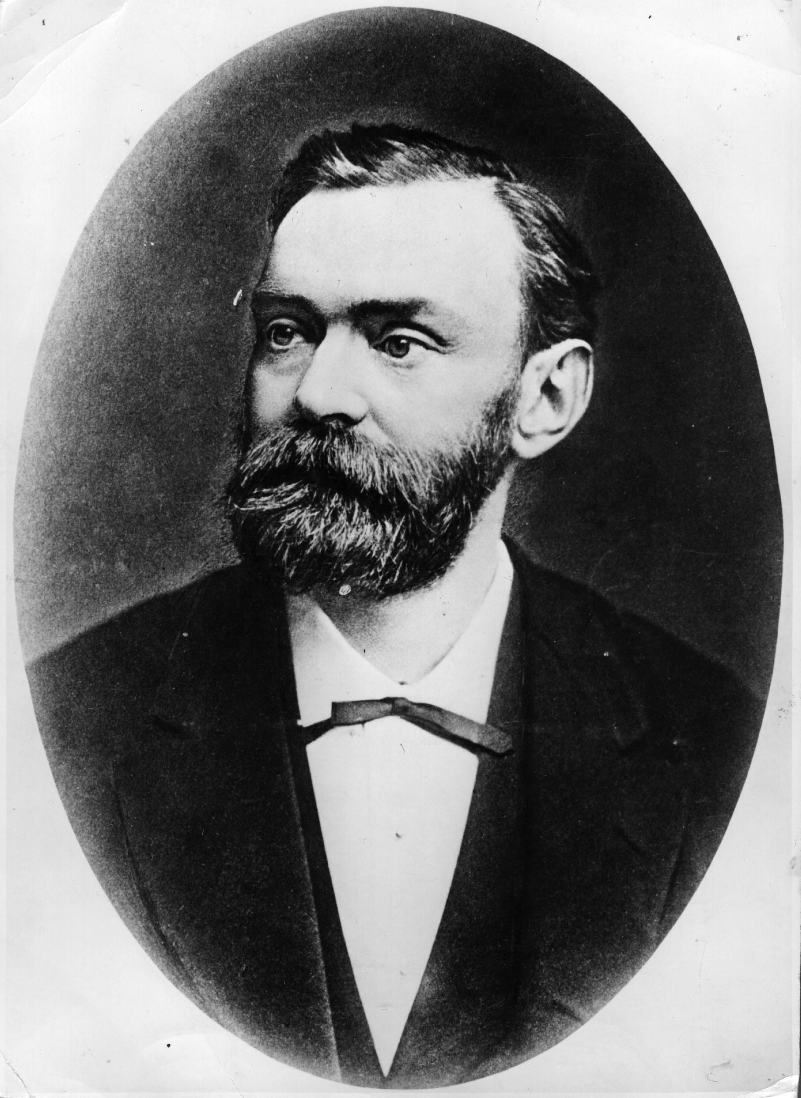
New Technology
Henry Bessemer- discovered how to make steel from iron
Alfred Nobel- invented dynamite

Slide 16
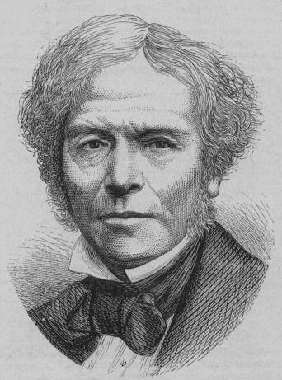
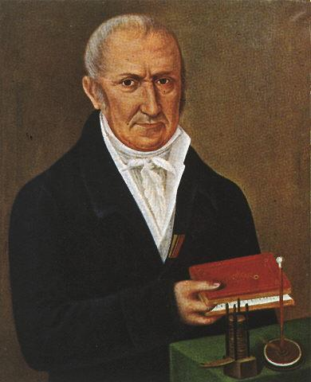
Electricity
Volta- Created the first battery in 1800
Michael Faraday- created the 1st electric motor.
Also created the dynamo- machine that generates electricity

Slide 17
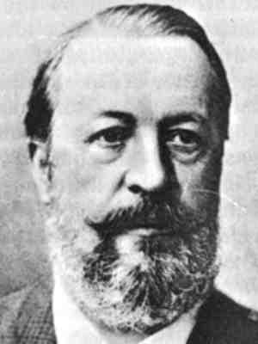
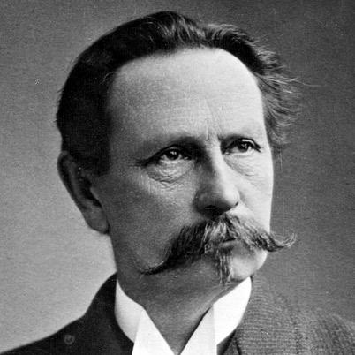
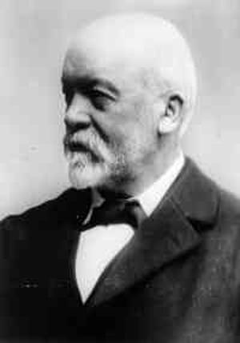
Automobiles
Nikolaus Otto- gasoline powered internal combustion engine
Karl Benz- 1st car, only 3 wheels(1886)
Gottlieb Daimler- 1st four wheel car in 1890

Slide 18
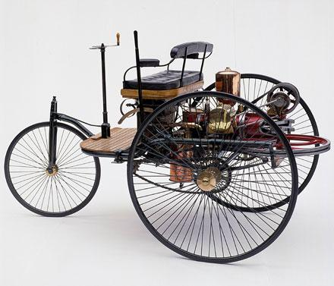
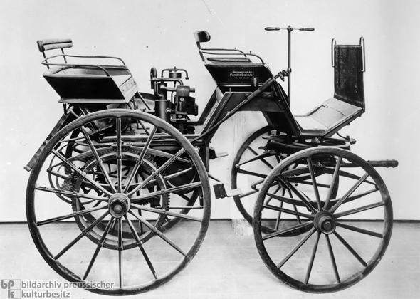

Slide 19
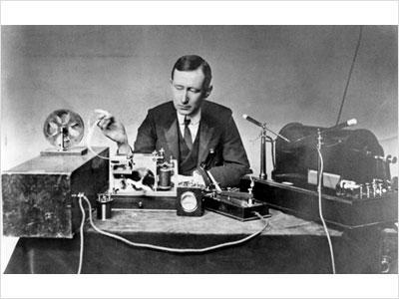
Communication
Telegraph- Samuel F.B. Morse; could send coded messages over wires
Guglielmo Marconi- invented radio in 1901

Slide 20
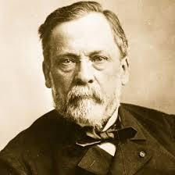
New ideas in Medicine
Cities/slums often led to disease
Germ Theory: certain microbes cause disease
Louis Pasteur- Discovered germ theory to be true
Pasteurization of milk

Slide 21
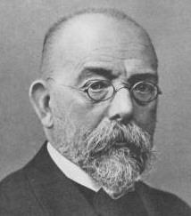
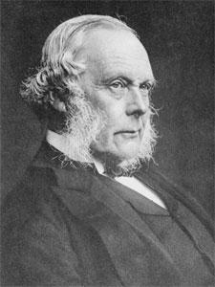
Medicine Cont’d
Robert Koch- discovered Tuberculosis (TB)
Joseph Lister- discovered antiseptics prevent infections
Urged doctors to wash hands before surgery
Population increased due to medical advances-death rate fell

Slide 22
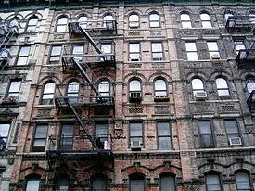
Social Impacts of the Industrial Revolution
Urbanization- movement to cities
Created a Middle Class and Working Class
Middle= wealthy
Working= peasant neighborhoods
Tenements- multi-storied buildings divided into apartments
No running water or sewage system

Slide 23
Labor Unions
Worker Organizations
Illegal, had to meet in secret
Wanted worker reforms
Less hours
Higher pay
Safer conditions

Slide 24
Conditions
Worked 12-16 hours, 6-7 days a week
Little to no breaks
Dangerous machines- lost limbs
Bad air quality

Slide 25
Urban Renewal
Rebuilding Slums
Most famous Paris
Paved streets, sewage systems, better buildings
Higher Standard of Living (measure of quality and comfort in society)

Slide 26
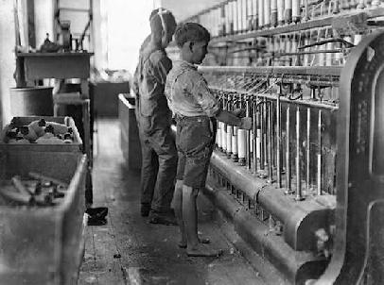
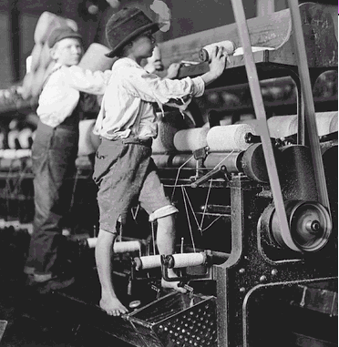
Women and Children
More women than men working because they could be paid less
Children worked at age 7-8
Small, quick hands
Repaired machines
Child Labor Laws in 1800, not strictly enforced.

Slide 27
Women’s Rights
Temperance Movement- campaign to limit alcohol
Women’s Suffrage ( Movement for Voting Rights): Lucretia Mott, Elizabeth Cady Stanton, Susan B. Anthony
Seneca Falls Convention 1848
Sojourner Truth- Ain’t I a Woman Speech

