Slide 1
The Korean War

Slide 2
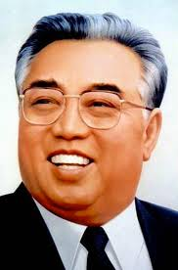
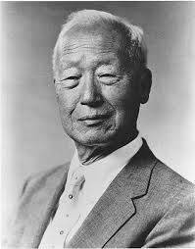
North vs South
North: Kim-Il Sung
South: Syngmann Rhee

Slide 3
Fighting Begins
North Korea invades the South June 25th, 1950
June 27th, the UN labeled North Korea as an aggressor and offered help
US decided to be the sponsor for South Korea

Slide 4
US Help
Air Strikes
Ground Troops

Slide 5
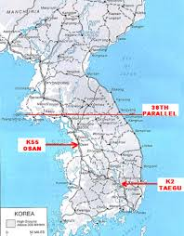
Osan
Americans and South Korean Troops are defeated in the city of Osan
North Korean Army better trained than expected
USSR helping the North

Slide 6
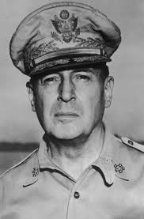
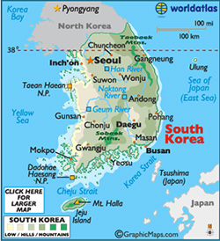
Inchon and Seoul
General MacArthur leads American troops to victory and takes Inchon and Seoul back from North Korea’s Army
US troops get up to North Korea’s capital
China joins North Korea

Slide 7
US gets pushed back
After China helps the North Korean Army, US troops get pushed back to the 38th parallel
Peace talks start 1951 but takes 2 years to agree

Slide 8
General MacArthur Fired
MacArthur publicly speaks out against Truman about what to do about China
Truman fires him, faces a lot of backlash from the American people who saw MacArthur as a WWII war hero

Slide 9
Peace
After a new president (Eisenhower) and more deaths, North and South Korea agree to a truce
Divide the country along the 38th parallel, just as it was before the war

