Slide 1
The Rise of Communism
China, Korea, and Vietnam

Slide 2
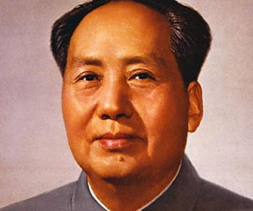
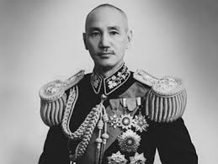
Communist vs Nationalist
Communist leader: Mao Zedong
Nationalist leader: Jiang Jieshi

Slide 3
Factors that turned China Communist
Large peasant population supported communism
communists redistributed land; rid of brutal landlords
Nationalism losing support
economic policies led to hardship
government corruption
relied on western powers

Slide 4
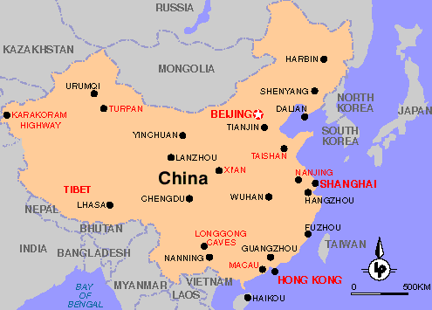
Communist Government Takes Over
Mao and his supporters took over key railroads to take over nationalist cities
Mainland China turned to communism 1949
Conquered Tibet in 1950

Slide 5
People’s Republic of China
Totalitarian 1 party government
Nationalists fled to Taiwan
Mao did not like traditional/buddhist beliefs
Collectivization-took over peasant land to increase production

Slide 6
Great Leap Forward
Economic program focused on increased production of agriculture
Failed- low quality food, bad weather led to famine
55 million starved to death

Slide 7
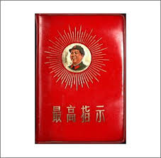
Cultural Revolution
Wanted younger generations to experience the glory of communist revolution
“Little Red Book”
Led to death, closure of schools, skilled workers being used for manual labor, almost caused a civil war

Slide 8
Relations with other nations
China and USSR allies but did not trust one another- eventually enemies
US and China-US supported Taiwan Nationalists
Later formed an alliance with China- tried to shun USSR

Slide 9
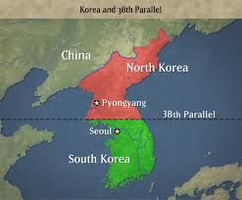
Communism in Korea
Territory of Japan during WWII
Divided Korea along 38th parallel of latitude
North=Communist Dictator
South=Non-Communist Dictator
North invades South and starts Korean War

Slide 10
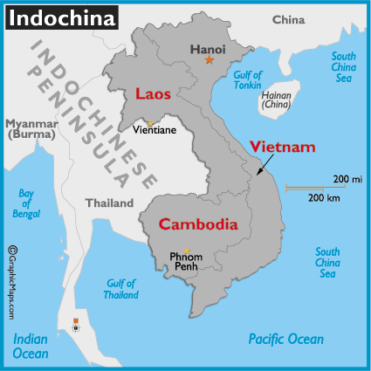
Communism in Vietnam
Before WWII, known as French Indochina
Used to be French in 1800s, Japan took over in WWII
Guerrillas- small groups of soldiers, fought French (after WWII) and Japanese (during WWII); wanted to get rid of foreign rule

Slide 11
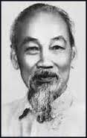
Communism in Vietnam Cont’d
After WWII, French try to reclaim Indochina, especially Vietnam
Ho Chi Minh- communist, led guerrillas to fight off French
Battle of Dienbienphu-Vietnam victory over French; French leave 1954
Vietnam split in 2, N=Commi, S=Democracy

